Slide 1
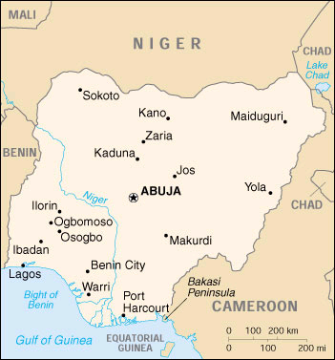
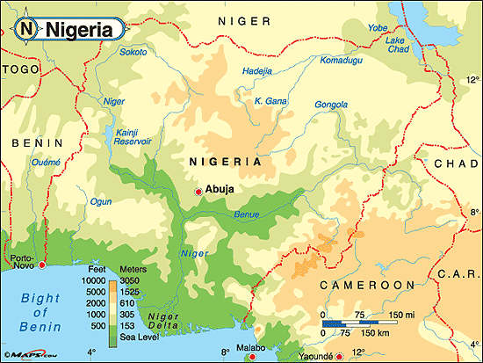
Nigeria

Slide 2
The mosaic of a diverse society
Nigeria is Africa’s most heavily populated country (130 million)
Also one of its most diverse (250 ethnic groups in Nigeria)
Dominant groups include the Igbo (Ibo), Yoruba, Hausa, and Fulani.
Also important religious divisions – Igbo are Christian, but the Yoruba, Hausa-Fulani are Muslim.
Muslims comprise about 50% of the population and Christians 40% with the rest practicing a traditional religion.

Slide 3
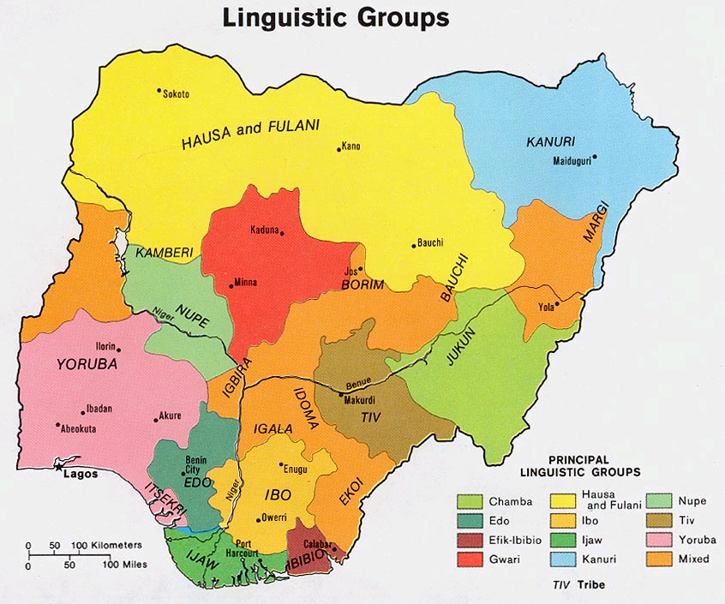

Slide 4
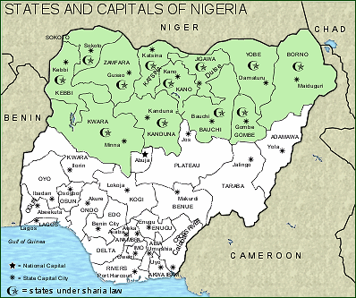
Islam and Christianity in Nigeria

Slide 5
Key Points
Nigeria’s democracy has been consistently undermined by antidemocratic tendencies and military misrule, much of it driven by avarice and greed.
There have been six successful coups since independence in 1960 as well as a civil war and military interventions abroad.
Will a country like Nigeria ever develop a functioning democracy?

Slide 6
Colonial Rule
Nigeria was a British colony from the mid 18th century until 1960.
The British practiced indirect rule as elsewhere, devolving power to local tribal leaders.
Hence Nigeria remained loosely integrated. The Muslim North and Christian South were not integrated until 1914.
Under British rule, the Christian South grew and developed while the Muslim north remained economically weaker, creating tensions that still exist today.
Britain further weakened national unity by establishing a federated state in 1939 along ethnic lines.

Slide 7
Federalism
After 1939, there were three states with separate administrative capitals – a western Yoruba state, an Eastern Igbo state, and a Northern Hausa-fulani state.
This led to the formation of regionally based ethnic parties who competed among each other rather than parties of national unity.
In the 1950s, Nigerian politics became more balkanized along ethnic lines with other minority ethnic parties demanding self-governance.
This led to the division of Nigeria from three states in the 1960s to over 36 states today.

Slide 8
The First Republic1960-1966
Nigeria’s first start at democracy after independence led to the creation of two broad political groups.
The center right Nigerian People’s Congress (NPC) was the party of the Muslim Yoruba and Hausa-fulani.
The center left National Conference of Nigerian Citizens (NCNC) was the party of the Christian Igbo.
Nigeria’s first elections produced led to an Igbo presidency under US educated Nnamdi Azikiwe and a Housa-Fulani prime minister.

Slide 9
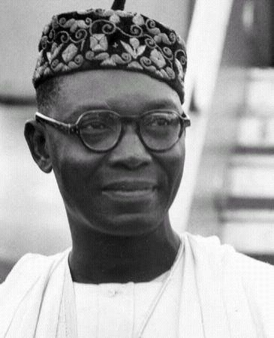
The First Republic1960-1966
Corruption became endemic and support for President Azikiwe quickly eroded.
The Yoruba in particular felt marginalized by the Azikiwe regime.
Struggles between Igbos and Hausa-fulanis also sparked violence.
After the 1964 elections, the north gained the upper hand.
Nnamdi Azikiwe “zik”
Pres. 1963-1966

Slide 10
Military intervention
The military intervened in early 1966, murdering the prime minister, the governors of the West and North, and some military officers.
Most of the coup leaders were Igbo and sought to remake the state into an igbo dominant entity.
This of course was met with fierce resistance among the other ethnic groups.

Slide 11
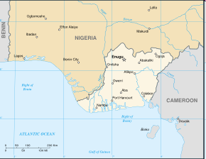
Civil war in Biafra
In July 1967, civil war broke out after a unilateral declaration of independence of the Republic of Biafra.
As many as 600,000 people died, mainly from starvation as the government cut off the food supply to Biafra.
July 1967, Republic of Biafra

Slide 12
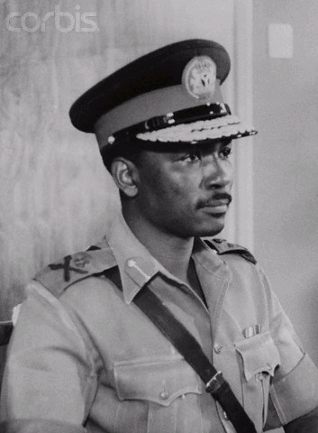
Military Rule 1966-1979
The 1967 coup, led by General Yakubu Gowon ushered in a long succession of military governments in Nigeria.
Gen Yakubu Gowon 1966-1975

Slide 13
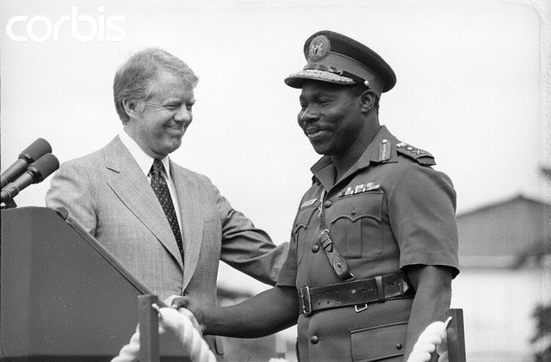
Transitioning Back To Democracy
The last military leader, Olusegun Obasanjo sought to reestablish democracy in Nigeria.
He prepared the country for constitutional reform in 1979 and transition back to a republican government.
Gen. Olusegun Obasanjo
1976-1979

Slide 14
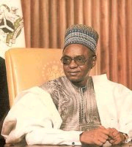
The Second Republic 1979-1983
In 1979, Shehu Shagari, a Hausa-Fulani, was elected President.
Pres. Shehu Shagari
1979-1983

Slide 15
The Second Republic (1979–83)
One of the most important developments in Nigeria’s political history was the 1979 constitution.
Established several important precedents – one was the creation of new federal states – increasing the number to twelve, and subsequently 19.
It also introduced a “federal character” clause which mandated equitable representation of Nigeria’s ethnic groups in state institutions, as well as equitable allocation of Nigeria’s oil wealth.
The constitution created a directly elected president and a bicameral legislature modeled closely to the US system.

Slide 16
Constitutional Reforms
Nigeria’s new constitution also sought to curb the influence of ethnic identity in political organization and leadership.
To win the presidential election, a candidate was required to garner an absolute majority of the electoral vote nationwide and at least 25% of the vote in each region of the country.
Hence, candidates could not win simply by appealing to a narrowly defined ethnic coalition.
Finally, the judicial system allowed Muslim states in the north to apply shariah law, but not against non-muslim citizens.

Slide 17
Failure of Constitutional Reforms
Despite all these efforts, Muslim-Christian tensions still flared.
The basic game of Nigerian politics did not change – take what assets you can from the common pool for your own ethnic constituencies.
This was especially true when it came to the administration of Nigeria’s oil wealth.

Slide 18
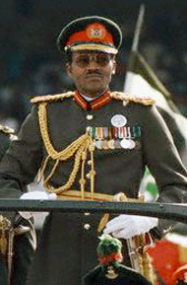
Military Rule 1983-1993
Poor leadership and corruption in the Shagari government set the stage for the next military coup by Maj. Gen. Mohammed Buhari.
Buhari was a northern Hausa-Fulani who ruled from 1983 until another coup brought him down in 1985
Gen. Muhammad Buhari
1983-1985

Slide 19
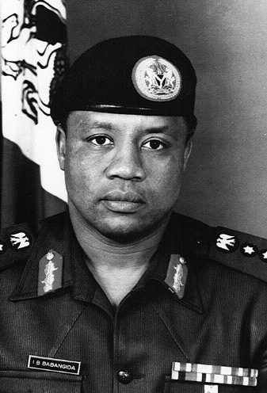
The next coup was led by another northerner, Maj. Gen. Ibrahim Babangida, who would become one of Nigeria’s most dictatorial and despised military leaders.
Gen. Ibrahim Babangida
1985-1993

Slide 20
Politics under Military Rule
Under Babangida’s rule, the military regime ruled for its own immediate benefit and wealth.
Nigeria became a pariah state subject to international sanctions.
Babangida earned a reputation as one of the most corrupt political leaders in Africa, along side Zaire’s Mobutu Sese Seko.
Babangida’s promise to transition to democracy was consistently manipulated and often deferred.
Presidential elections were first slated for 1990, but were set aside until June 1993, when Babangida finally agreed to new elections.

Slide 21
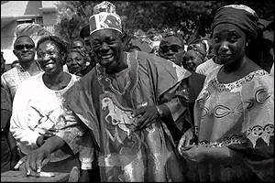
Failed Third Republic 1993
When June 1993 elections took place, a traditional Yoruba leader, Chief Moshood Abiola won a majority of votes.
Babangida first promised to step down, but then reneged and declared the election results null and void.
Ultimately, Babangida was forced to leave under pressure, and an interim government was set in place.
Yoruba Chief Moshood Abiola casts his ballot in nullified 1993 presidential election

Slide 22
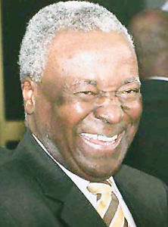
Interim Government of 1993
The “interim” civilian government under Ernest Shonekan fell within months to another military coup.
The latest military coup was led by an especially inept and corrupt military dictator, Sani Abacha
Interim Pres. Ernest Shonekan 1993

Slide 23
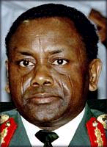
Return to Military Rule
Abacha, a northerner from the Kanuri group, ruled with an iron fist
He and his subordinates engaged in the systematic theft of the nation’s wealth.
Dramatically, Abacha succumbed to a heart attack on June 8, 1998
Gen. Sani Abacha
1993-1998

Slide 24
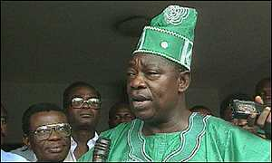
Return of Abiola?
Hopes rose that Yoruba Chief Moshood Abiola would now lead a transition to democracy, but exactly one month later, Abiola died suddenly in the middle of a meeting with U.S. and Nigerian officials.

Slide 25
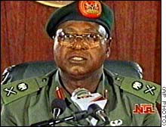
Transitional Government
In 1998, the military conceded that continued rule was no longer possible.
A transitional government under Gen. Abdulsalami Abubakar prepared the country for new elections in 1999.
Gen.Abdulsalami Abubakar
1998-1999

Slide 26
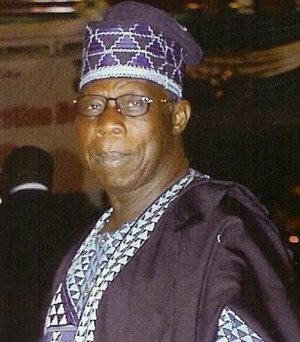
Rise of Fourth Republic
The 1999 elections were a major turning point for Nigeria.
Former General Olusegun Obasanjo won a lopsided victory
The vote was deemed less than free and fair by independent Nigerian and international observers—including opposition leaders, who claimed they were fraudulent.
Pres. Olusegun Obasanjo
1999-2007

Slide 27
The Fourth Republic
Despite the apparent irregularities, Obasanjo, a Yoruba, built a broad based multi-ethnic coalition of support garnering over 60% of the popular vote.
On May 29, 1999, the military formally stepped aside and civilian rule returned to Nigeria.
Many have hoped that Obasanjo would be able to turn Nigeria toward a more democratic future.
Skeptics however pointed out that Nigeria’s tradition to democracy had been undermined systematically for years by military officers and inept civilian leaders.

Slide 28
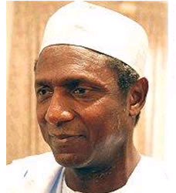
Successful transition of Power
In 2007, Obasanjo’s hand picked successor Umaru Yar'Adua, an aristocratic Hausa-Faluni from the north, won the presidency in what was generally considered a flawed election.
To his credit, Umaru Yar’Adua was committed to democratic reforms and fighting corruption.
But as governor of a northern province, he extended shariah law before becoming president.
Umaru Yar’Adua
2007-2010

Slide 29
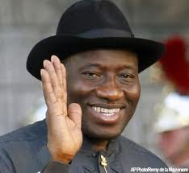
On May 5, 2010 Yar’Adua died as a result of complications from heart disease
Goodluck Jonathan, a Christian from the Ijaw ethnic group, was appointed as his successor.
Goodluck Jonathan subsequently won a 59% of the vote in 2010 Presidential Elections, with support largely in the Christian South.
Goodluck Jonathan
2010-present

Slide 30
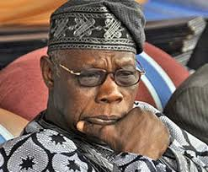
Return of Obasanjo?

Slide 31
Prospects for Democracy in Nigeria’s Fourth Republic
Elites committed to democracy?
Before Obasanjo, no.
Nigeria was a kleptocracy. Current President Goodluck Jonathan may be committed but the status of other elites is uncertain.
State institutions?
Well conceived in theory, but weak and unstable in practice.
Corruption is a major problem in Nigeria’s state institutions. Historically, there has been little respect or enforcement of the rule of law.

Slide 32
National Unity?
Nigeria’s ethnic and religious divisions have been a constant source of tension.
Clashes between Christian and Muslim extremists have continued under Goodluck Jonathan’s presidency.
Building a stronger sense of national unity will be difficult.

Slide 33
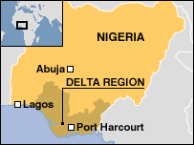
National wealth?
The Nigerian economy is highly dependent on a single resource- oil.
Oil accounts for 95% of state revenues, most of which has historically been squandered by corrupt leadership or laundered abroad.
High oil prices are increasing Nigeria’s tax revenues, and Nigerian oil production is also dramatically increasing, but where will the money go?
Oil!

Slide 34
Nigeria remains one of the poorest countries in the world with a GDP per capita of less than $600.
The oil wealth could serve as a base for consolidating democracy if channeled in the right direction – not likely
Private enterprise?
Nigeria’s corruption inhibits the growth of private enterprise.
Nigeria is rated as one of the most corrupt places in the world to do business.
Rooting out corruption will be critical to attracting more foreign investment and building an economy based on anything other than oil.

Slide 35
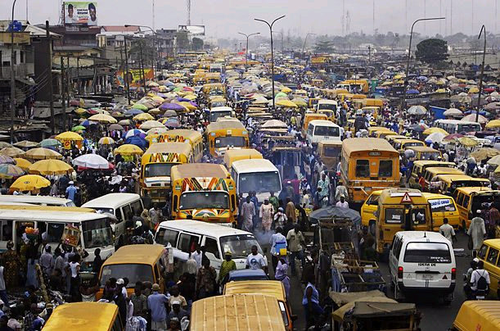
Middle Class?
Nigeria does have a growing middle class, but it receives little benefit from the oil wealth and is unstable and small compared to the vast underclass of urban and rural poor.
Streets in Lagos

Slide 36
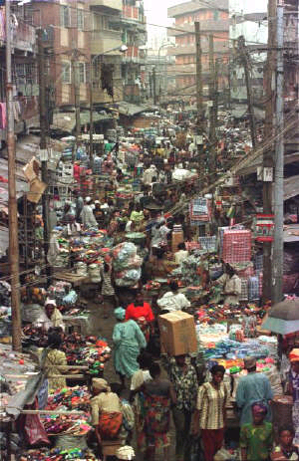
Support for the Disadvantaged?
Nearly 90% of Nigeria’s population live on less than 2$ a day, 71% on less than $1 per day.
Malnutrition and lack of sanitary water are major problems.
AIDS is a growing rather than a declining problem, and the average life expectancy is only about 46 years.
Streets in Lagos

Slide 37
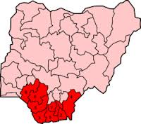
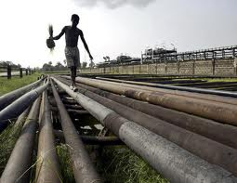
Civil Unrest
Rebellions in the oil rich Niger Delta region have halted drilling at times.
Other ethnic groups also claim that they are being cut out of their share of the oil wealth.
Hence, many of Nigeria’s disadvantaged do not feel that they are being given adequate support by their government.
Undermines government legitimacy – fuels conflict
Delta Rebels

Slide 38
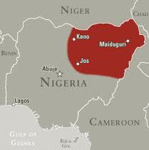
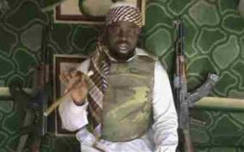
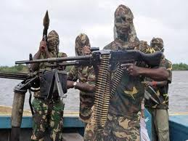
Boko Haram
“People Committed to the Propagation of the Prophet's Teachings and Jihad”
Increasing concern about State
Failure and Radical Islam in
Northern Nigeria

Slide 39
Citizen Participation, Civil Society, Democratic Political Culture?
Nigeria’s political culture is highly organized along ethnic and religious lines.
Most Nigerians are supportive of democratic reforms and put pressure on the military governments to step down.
The question of whether there is a culture of mutual respect, tolerance, and willingness to settle disputes peacefully is doubtful.

Slide 40
Education and Freedom of Information?
Illiteracy in Nigeria is high (35%) or greater in rural areas.
Although the country has a reasonably well-developed free press, the quality and content of that information is not reaching many in the population.
Favorable international environment?
Nigeria has devoted substantial resources in the past policing civil wars in neighboring countries like Sierra Leone, and Liberia.
Nigeria has been committed to expanding the ECOWAS system, but it also bears a disproportionate financial burden for regional integration, compared to its poorer neighbors.

Slide 41
Conclusions
The evidence from Nigeria’s experience with democracy since independence, and from its current situation, is doubtful.
One unfortunate certainty is that the direction that Nigeria takes will surely have a profound impact on the politics of West Africa.
Where Nigeria goes, so goes West Africa?

