Slide 1
Highlights from the syllabus
Unit 1, 2, 3 tests (45%)
Unit 1 & 2 papers (20%); Self-Assessment paper (10%)
Final Exam: Final test (long essay) (10%)
Professionalism and engagement (15%)
Attendance: 5 misses = withdrawal (work with me here)
Absences and access to lectures online—usually not an option
Leaving early for breaks and the end of the term = 0 on any assignments (but I try to plan to accommodate)
Read carefully the syllabus sections on the Honor Code, distributing class materials/lectures anywhere, & especially about the use electronic devices

Slide 2
What is the study of political science about? How do we study political science?

Slide 3
POLITICS IS?:
The pursuit of the “good society” (Aristotle)
The exercise of “power” (Machiavelli)
The “processes” by which of things of value are “allocated” (Harold Lasswell)
A means of resolving personal “conflict” short of using force, and aggregating force for social ends (Thomas Hobbes, social contract theory)
The “competition” among individuals and groups (Robert Dahl’s “pluralism”)
The “struggle” between groups to define what “reality” is within the public sphere (post-modern theory) … (http://www.pewresearch.org/fact-tank/2018/08/23/republicans-and-democrats-agree-they-cant-agree-on-basic-facts/)

Slide 4
SO, A WORKING DEFINITION OF “POLITICS”
Politics is the process… whether it be conflictual or consensual…
through which power is used within and/or by and/or with impact on the public sphere…
in the promotion of certain values , interests,
or realities

Slide 5
HOW IS POLITICAL SCIENCE DIFFERENT THAN MAKING EVEN WELL-INFORMED POLITICAL ARGUMENTS?
Political science is a discipline that is divided into specialized “fields”: (1) American politics, (2) comparative politics (3) international relations, (4) public policy, and (5) political philosophy… And many, many subfields.
What are the strengths and limitations of having “disciplines”? (aka “academic silos”?)
What do political scientists mostly agree on, such that we can call ourselves a discipline? We agree on epistemology: Specifically, we believe in the scientific method as the way of knowing how the world works so that we can use that knowledge for normative ends: Most political science is mostly empirical rather than normative. It mostly seeks to focus on causal analysis (explanatory and predictive). And it typically relies on inference from a small set of cases to generalize.

Slide 6
HOW DO WE STUDY POLITICS SCIENTIFICALLY?
Political science is fundamentally different than much of the informed public opinion that causes many people to be interested in politics. The key difference is that science requires you to test your arguments as rigorously as you can and to be open the idea that your theories and hypotheses may well be wrong.
Generally speaking, a “scientific” political science argument is objective, empirical, testable falsifiable, generalizable, replicable, and hopefully cumulative?
Why use the scientific method?
The method of testing theories and hypotheses by applying certain rules of analysis to the observation and interpretation of reality under strictly delineated circumstances (transmissible). Do this, and you can sometimes replicate and build knowledge
Is political scientific inquiry all quantitative (all #s)? Or is there plenty of room for qualitative inquiry? (No, PSC isn’t all #s) do HPU’s PSC majors have to take at least one class that focuses heavily on stats?)
Any objections to this approach? Postmodern complaints; human behavior is incredibly complex; too statistical and too focused on issues that don’t matter; too conservative (methodologically, not ideol.)

Slide 7
Why study politics scientifically?
To be better informed. What do Americans know about politics… Not as much as you would hope (follow the link yourself (2019): https://www.pewresearch.org/politics/quiz/what-do-you-know-about-the-u-s-government/
To use evidence to think for ourselves. Can Americans tell the different bw fact and opinion? (No, follow the link yourself): http://www.pewresearch.org/quiz/news-statements-quiz/
Why is disinformation is so prevalent? Leaders lie all the time (Some current evidence): https://www.politifact.com/personalities/donald-trump/ https://www.politifact.com/personalities/joe-biden/
The PSC approach will help you be a better political analyst of and advocate for your views: We are biologically wired to overgeneralize and make all kinds of heuristic errors in information processing. See Danziger for an overview.

Slide 8
Let’s be social scientists… This approach can help us understand and address complex issues better:
(1) How much in debt is the US? Which party is most responsible? What is the main source of America’s debt?
(3) Who’s right about globalization? Trump (China is winning so Americans are losing) or the American left (the rich are winning, and the poor are losing)?
(4) How accurate is it to say that if you have high taxes or high regulation, your economy and everyone in it will suffer greatly?
(5) Which party, when in control, makes rich Americans richer and poor Americans poorer? Why?
5) Gelman and Azari: Why did (some) political scientists so under-estimate Pres. Trump’s odds of winning in 2016? How did the discipline correct itself to mostly get 2020 predicted correctly? See the article

Slide 9
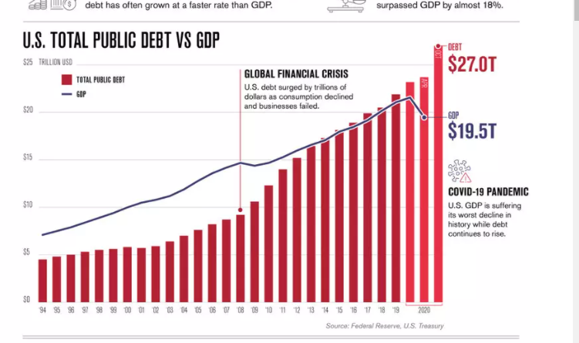

Slide 10
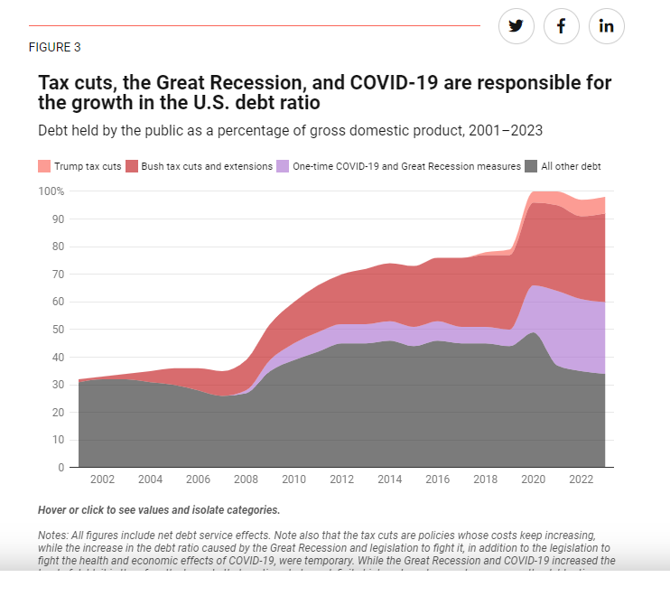
https://www.americanprogress.org/article/tax-cuts-are-primarily-responsible-for-the-increasing-debt-ratio/

Slide 11
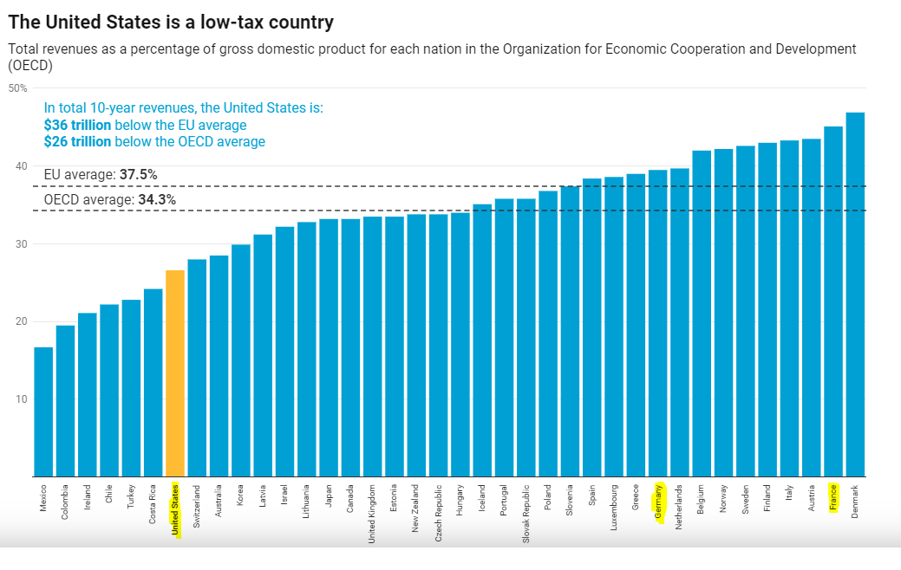

Slide 12
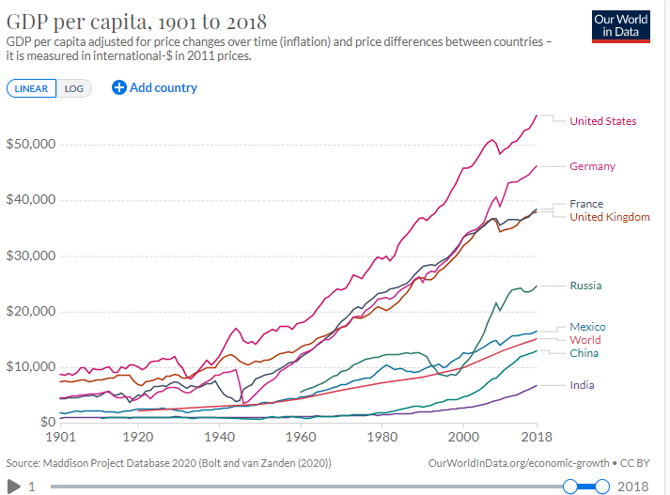

Slide 13
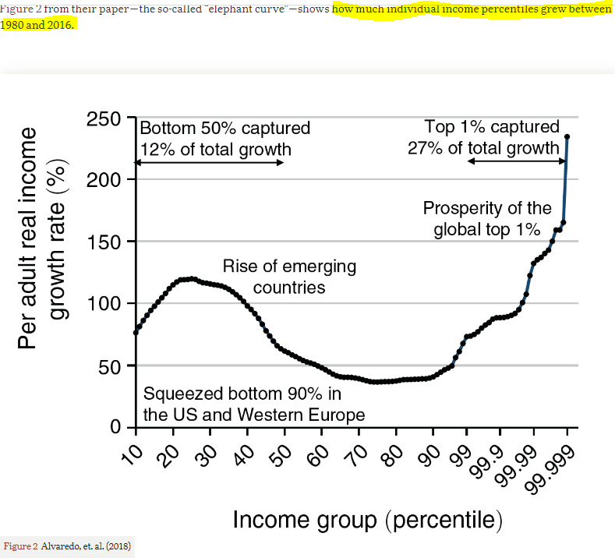

Slide 14
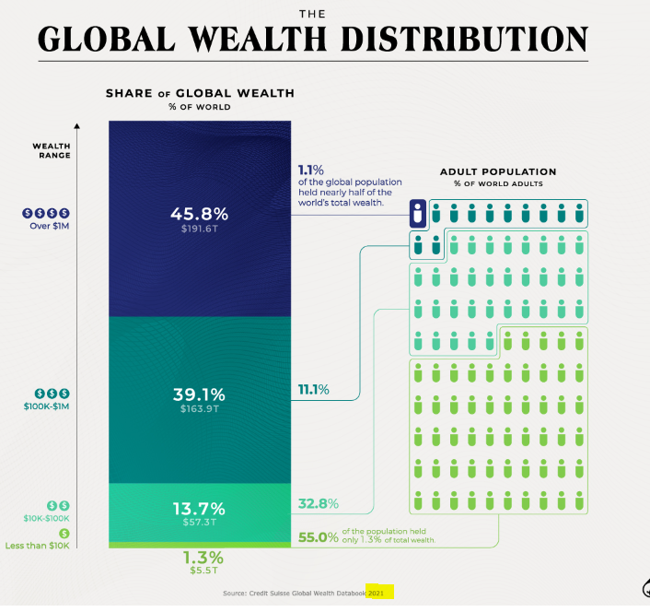

Slide 15
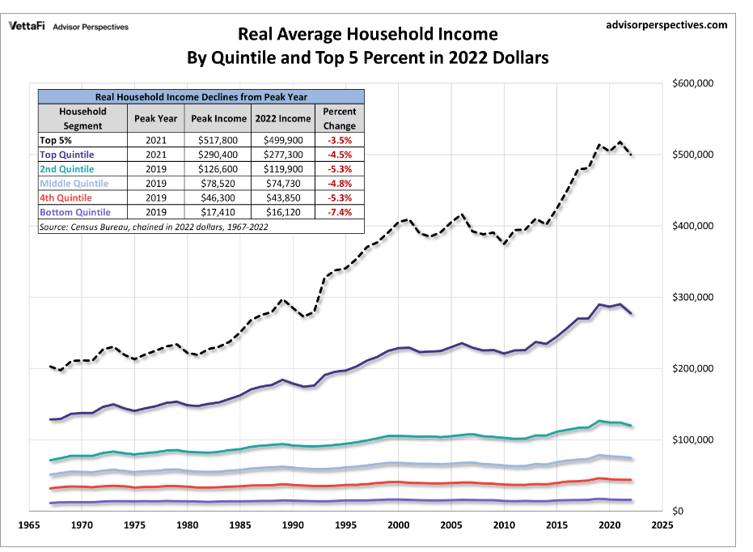

Slide 16
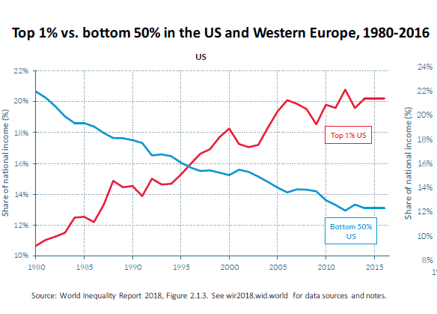
Does globalization hit all AIDs the same, making growing inequality unavoidable? US

Slide 17
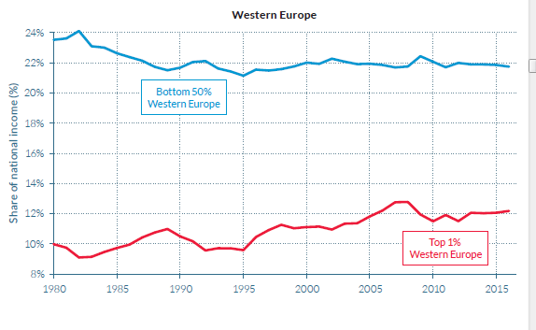
And then W. Europe

