Slide 1
Highlights from the syllabus
How do I get access to the course materials again? If you have added the class or need additional information, shoot me an email. I will email you instructions on how to access the website.
InQuizitive quizzes (10%): take them w/in 3 days of when they are listed. Let me know if you have any difficulties in registering. Instructions are in the course schedule.
Unit 1 tests (45%)
Unit 1 & 2 papers are optional: replace 50% of unit test grades.
Opinion essay (10%)
Final exam: Comprehensive essay (15%)
Professionalism and engagement (20%): Read the rubric for specifics.
Attendance: 5 avoidable misses = withdrawal. Communicate and I can be flexible!
Leaving for breaks and the end of the term = 0 on any assignments missed.
Read carefully the syllabus sections on academic integrity, distributing class materials/lectures, & using electronic devices. If you have accommodations, send me a message in the next week.

Slide 2
What is the study of International Relations about? How does political science study IR?

Slide 3
WHAT ARE WE GOING TO DO IN THIS CLASS?
What three big questions (units) will we study?
(1) Why do countries act the way they do?
(2) When/how do states work together? When are they in conflict (with a focus on war and trade)
(3) What “game changers” are emerging in the 21st century? (with a focus on intl. development, US hegemony, rise of China, and WMDs)

Slide 4
WHY SHOULD YOU CARE ABOUT THE CONTENT OF THIS CLASS?
What will the world look like in 20 years? In 40 years? In 60 years? How long will you be a professional? How involved will you be with the “intl. community”?
Lots of supposedly “domestic” issues require international collaboration or coordination
  Off-shoring issues (jobs, pollution, human suffering, terrorism)
  Collective dilemmas/opportunities (trade, the global environment, pandemics nuclear security)
What are the unique obligations and benefits of being an American citizen (e.g., US hegemony, living in a liberal democracy, having lots of nuclear weapons (and the nuclear “umbrella,” controlling the globe’s main currency, and being a member of NATO and permanent member of the UN’s Security Council)?

Slide 5
WHAT DO YOU NEED TO KNOW COMING INTO THIS CLASS?
What do young Americans (college students) know about key facts in IR? Watch on your own if you would like:
https://www.msnbc.com/morning-joe/watch/global-illiteracy-on-display-in-college-survey-764688451919
Some data on young folks:

Slide 6
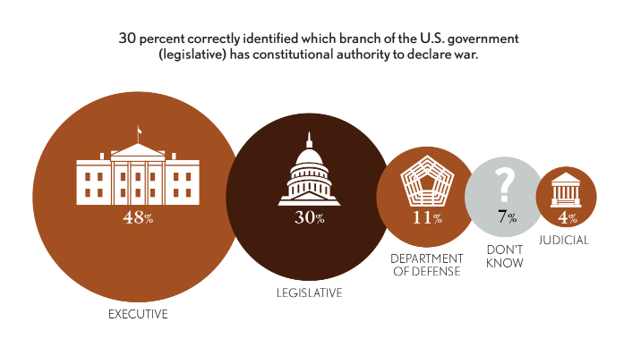

Slide 7
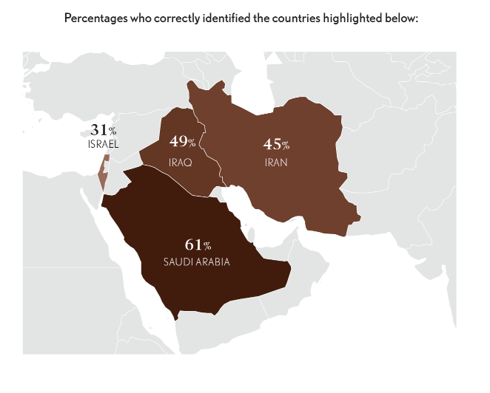

Slide 8
WHAT DO YOU NEED TO KNOW COMING INTO THIS CLASS?
If you want, figure out some of what you already know and don’t about intl. affairs:
https://upgrader.gapminder.org/t/sdg-world-un-goals
The bottom line: Most young Americans (older ones, too!) don’t know key, empirically testable, facts about international politics let alone the rules, processes, and institutions of the intl. system, powerful foreign countries, or even American government.
  Why don’t Americans know more?
  Is it too damn hard to know what’s going on? Not really because you don’t need to know everything. A dozen or so countries and organizations matter most.
  Disciplines are part of the problem… Even “Americanists” and many “Comparativists” in political science don’t know all that much about the world.
  Even academics learn information in silos and then we live in media and social silos.
  Our leaders frequently do not tell the truth: https://www.politifact.com/personalities/donald-trump/
  https://www.politifact.com/personalities/joe-biden/
  Something we will talk about quite a lot later on: Our brains are hard-wired to process information in ways that do not help us to make rational, systematic decisions. Instead, we focus on what’s present/available vs. what’s most important; and we defer to leaders’ views about what is important.

Slide 9
WHAT DO WE STUDY IN STUDY IR?
What is the international system and how does its structure dictate behavior?
  Basically the system is structure, process, norms, and institutions we’ve used to organize humanity for the last 500 years or so: in states.
  The system has no binding international authority (i.e., it’s anarchical and self-help). Because of this, the system is one that typically recognizes the sovereignty of states
Why do states behave differently in some ways but not others? States are very different internally—and clearly respond to internal pressures—but they also act in some quite predictable ways, using various types of power (which we will talk about shortly). States often treat others and have expectations in international relations that do not apply domestically
What’s going on in the international system? Are we entering a new system?
  The contemporary state system—now around 200 states—emerged within a small time window and in direct response to material changes and functional needs. Because of globalization, interdependence, and technological revolutions in transportation, weaponry, and communication, the need & role of the state is changing very rapidly.
  And we may be leaving a brief period of one-state (the US) dominance. And we may be leaving a set of international norms built over the last century.

Slide 10
WHAT ARE SOME OF THE KEY CONCEPTS THAT YOU NEED TO KNOW RIGHT AWAY?
What is power? This is the main concept IR studies
What are the main strategies that states use to exercise power (see Greenstein and Pevehouse) on one another and to address collective goods problems:
(1) Dominance, (2) reciprocity, and (3) identity
How do these strategies correspond to the major theories of IR: (1) realism, (2) liberalism, and (3) constructivism?
What are the main tactics (vs. strategies) use to exercise power?
  Non-consensual power tactics: What is hard power and how is it different from sharp power? Kastner and Wohlforth use the term “subversion" as a synonym for sharp power.
  Consensual (i.e. hegemony) power tactics: What is soft power, and how is it different from sticky power?

Slide 11
WHAT ARE SOME OTHER KEY CONCEPTS THAT YOU NEED TO KNOW RIGHT AWAY?
What are the three main theories that IR uses to try to predict how power is used by states and within the international system?
Realism (Realists): Anarchy means states dominate or be dominated
Liberalism (Liberals): States work better when we cooperate in domestic and intl politics… And everyone is going to figure that out sooner than later.
Constructivism (Constructivists): The future--what is important, how we act, whether we fight/collaborate—is what our leaders and we choose to make it… It matters whether Trump or Biden leads or how we see the rise of China.
Radical (Marxism – dependency theory) are less important for us
A big point that will help you later on: Theories explain or predict outcomes. Thus, states aren’t “realist” or “liberal,” but their leaders may act in ways that realists would anticipate and some political leaders are realist in their assumptions about how to use power and think about their country’s relationship with other countries.

Slide 12
WHAT YOU SHOULD LEARN FROM MLK’S SPEECH?
What were the major themes/arguments in the part of the speech you listened to?
What is empathy and how might nationalism or tribalism undermine it? Why did King suggest that we use it? What did he mean when he said (not in the video) that “injustice anywhere is a threat to justice everywhere” (originally used to justify his presence in Birmingham, but in his later years he felt the same about US foreign policy)?
What IR theory and power does he see as explaining US foreign policy since WW2? What does he think should guide US behavior? (Hint: MLK thinks the US should be guided by ideas from liberalism, “radical” theory, and constructivism. He rejects realism and says using hard and sharp power harms American interests.
Why does King think that the US—once a strong proponent of revolution by the oppressed—has so frequently sided with the oppressive leaders in developing countries? Is this still the case?
King argues that the modern international system is driven primarily by nationalism, capitalism, and political ideology. What does he see as the alternative? (Being a “citizen of the world”; “person-orientated” vs “thing-orientated”)
Why does King think that everyday people—especially, US citizens—should be knowledgeable about global politics and try to change things? (What is our moral obligation to foreign places, and what does he mean we sometimes play a role in “spiritual death”)

