Slide 1
BEYOND THE BINARY
How Knowledge from Religion, Science, and Personal Contact Influence Hostility Toward Transgender Rights
presented by: MAGGIE SELMAN

Slide 2
INTRODUCTION
Question #1
Where do people get the knowledge that informs their attitudes toward transgender folks?
In 2022 and 2023, state legislatures introduced 250 and at least 142 anti-trans bills, respectively. Yet, 64-73% of Americans support laws protecting trans people from discrimination.
This research will provide insight into the root causes of hostility toward transgender people as measured by three variables intended to gauge variations in hostility by type of right.
Question #2
Why do people display more hostility toward certain types of transgender rights but not others?

Slide 3
01
Cognitive Consistency: We naturally want our attitudes, beliefs, values, and behaviors to align with one another. We are especially “constrained” by our religious and ideological identities/beliefs (Kruglanski et al. 2018)
THEORIES
02
Education for Prejudice Reduction: Several studies (Morrison, Duncan, and Parton 2015; Tondok, Suryanto, and Ardi 2022; McKown 2005) find that education may be an effective means of reducing prejudice. Other studies suggest scientific knowledge is an antagonist to religious teachings on certain moral and social issues.
03
Contact Theory: Contact between an in-group and out-group reduces prejudice by encouraging the groups to find commonalities and humanity within each other (Pettigrew and Tropp 2006). Prior research shows contact is correlated with more positive attitudes toward trans identities, but its effects of attitudes toward policy varies.
Notes:
Contact: Flores, Lewis et al., and Cao & Gurcay found that this principle applies to LGBTQ+ folks.

Slide 4
HYPOTHESES
H
Those who say religion has a significant impact on their views of trans people are more likely to express greater hostility toward both civil and body-centric transgender rights than those who do not cite religion as a significant influence on their views of trans people.
Those who do not cite knowledge gained from science as a significant influence are more likely to exhibit greater hostility toward both civil and body-centric trans rights.
Those who do not cite familiarity with a trans person as a source of their attitudes are more likely to display greater hostility toward trans rights, but the effects of contact (or lack thereof) will not be as strong as other factors.
1
H
2
H
3

Slide 5
DATA & MEASUREMENT
Independent Variables
Pew Research Center’s American Trends Panel Wave 109
  Conducted May 2022
  10,188 respondents
  Stratified random sample
How much has each of the following influenced your views about whether someone’s gender can be different from the sex they were assigned at birth?
  Your religious views
  What you’ve learned from science
  Knowing someone who is transgender
a great deal
not at all
1
5

Slide 6
Dependent Variables
1
strongly favor
Would you favor or oppose laws or policies that do each of the following?
  Protect transgender individuals from discrimination
  Require health insurance companies to cover medical care for gender transitions
  Make it illegal for health care professionals to provide medical care for a gender transition to minors
  Investigate parents for child abuse if they help a minor get medical care for a gender transition
5
strongly oppose

Slide 7
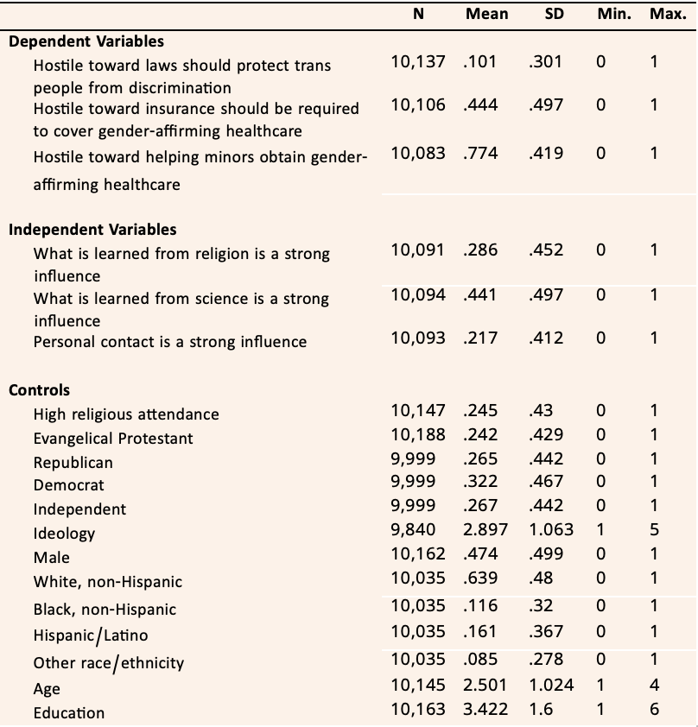
DESCRIPTIVES

Slide 8
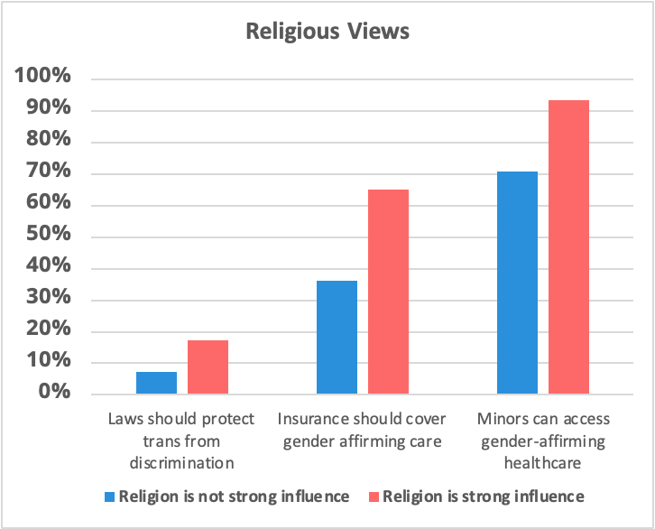
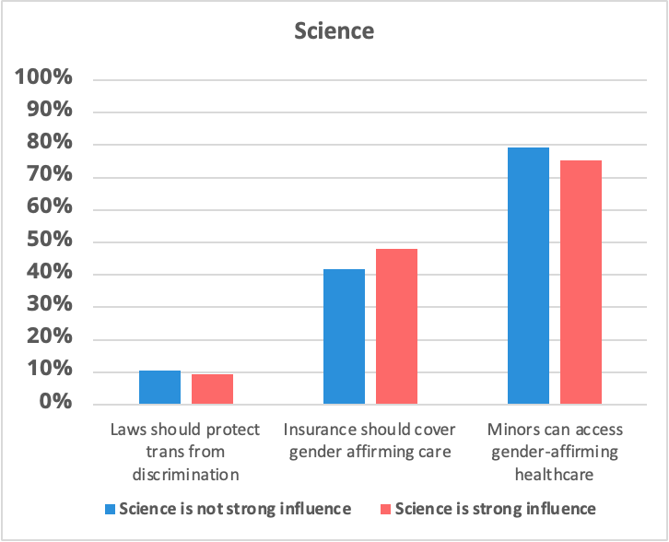
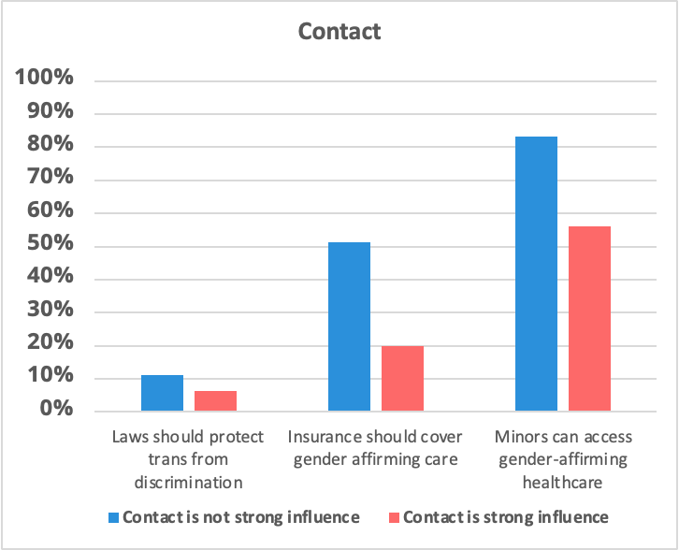
BIVARIATE ANALYSIS
Notes:
These charts show the percentage of respondents in each category who expressed hostility before controlling for other factors

Slide 9
CONCLUSIONS
  Hypothesis 1: Religious Views
  Hypothesis 3: Contact
Those whose attitudes come from their religious views had a consistently higher likelihood of displaying hostility across all measures. Although, the difference between strong and weak influence are less drastic when controlling for other factors.
Hypothesis 3 was partially correct. As predicted, attitudes stemming from contact were more than 50% less likely to be hostile. Contrary to the prediction, however, these results extended to body-centric rights but not civil rights.
  Hypothesis 2: Knowledge from Science
  Implications
Hypothesis 2 was proven false. Though attitudes gained from science were less likely to display hostility on civil rights, such attitudes were correlated to higher hostility on one body-centric rights measure (insurance) and had no correlation on the other.
1) Target religious beliefs: spread a stronger message of tolerance toward LGBTQ+ folks and acceptance of trans identities
2) Promote contact between transgender people and religious communities.

