Slide 1
FATE, RANDOMNESS, &
ECONOMIC POLICY
ATTITUDES
MADISON DEANE | MDEANE@HIGHPOINT.EDU

Slide 2
MAIN RESEARCH QUESTION
How do worldviews underlying popular understandings of poverty, namely those worldviews that attribute poverty primarily to factors within neither individual nor societal control, influence attitudes toward redistributive economic policy?

Slide 3
WHY ASK THIS QUESTION?
Incomplete picture of poverty attribution frameworks and economic policy attitudes
Effects of individualism and structuralism known, “fatalism” less so
Concept of fatalism fails to consider predeterminism/plan and purpose
Promising research on the effects of fatalism in other areas
Shown to influence motivation and effort
Health-related tasks, donation
Importance of attitudes toward redistributive economic policy
30% of the U.S. population/99.1 million people participated in the social safety net in 2019
Nearly one out of every 2 children
Can help explain and predict public support for social programs
Useful for activists/politicians who compose and broadcast messages on these issues

Slide 4
CONCEPTS AND THEORY
Existing research has established several worldviews, or “metatheories,” underlying popular understandings of why some people are particularly wealthy or poor.
Individualism: Individual choices and behaviors
Structuralism: Greater social forces such as globalization, the economy/economic policy, geographic conditions, and systemic discrimination
Fatalism: “Factors over which neither the individual nor the society has much control,” including “fate and bad luck, inborn lack of ability or talent, and disability and illness, among many other unfortunate circumstances”

Slide 5
CONCEPTS AND THEORY
However, the metatheory dubbed “fatalism” must be further broken down.
The term “fatalism” implies a belief in predeterminism/a plan and a purpose One can attribute poverty to factors “over which neither the individual nor the society has much control” without believing these factors to happen for any particular reason
Thus, “fatalism” becomes “fatalism” (2.0) and “randomness”
These new metatheories attribute poverty primarily to factors within neither individual nor societal control depending on whether those factors are perceived as happening for a reason (fatalism) or not (randomness)

Slide 6
CONCEPTS AND THEORY
Within Individual Control
Beyond Individual Control
Metatheory:
Individualism
Within Societal Control^{P}
Within Neither Individual nor Societal Control
Metatheory:
Structuralism
Not Predetermined
Predetermined
Theoretical Diagram
Metatheory:
Randomness
Metatheory:
Fatalism

Slide 7
CONCEPTS AND THEORY
Do real people think in these ways?
“In your own words, why do you think terrible things happen to people through no apparent fault of their own?”
PEW RESEARCH CENTER | NOVEMBER 19, 2021

Slide 8
INDIVIDUALISM
“God, or the force, gives you free choice. That is his, her, its gift to you. What you do with your life is up to you. Your fate is NOT pre- ordained.”
Mainline Protestant, age 50+
“There are consequences to every choice we make. When bad things happen, they can be tied to a choice that was made.” Evangelical Protestant, age 50+
“People have some responsibility for what happens to them 90% of the time.”
Catholic, age 50+
“We all have the power of choice.”
Catholic, age 50+
PEW RESEARCH CENTER | NOVEMBER 19, 2021

Slide 9
STRUCTURALISM
“Systemic injustice such as racism and misogyny.”
Catholic, age 18-49
“In sociological terms, preexisting wealth and systems are in place from generations past that put certain people at an advantage or disadvantage depending on their birth (i.e., what family they are born into, their skin color, their gender/gender expression, sexuality, etc.)...”
Religiously unaffiliated, age 18-49
“Environmental issues and extremely poor government involvement to enlist scientific-based solutions to these issues. Also, no accountability involving the corporate giants causing the pollution. A lot of people have no path to education, no access to good fresh vegetables and fruits. Medical institutions pushing medicines without finding the actual cause and conditions going undiagnosed. Hospitals controlling the majority of medical practices preventing surgeries when possible. Guns, guns, guns.”
Evangelical Protestant, age 50+
PEW RESEARCH CENTER | NOVEMBER 19, 2021

Slide 10
FATALISM
“God is merciful always and although difficult to understand, there is always meaning in suffering.”
Catholic, age 50+
“I feel like people go through things due to their karma. Also due to the fact that the things that
they are put through make this who they are.
Everything happens for a reason, whether they are good or bad, they make you unique.”
Spiritual but not religious respondent, age 18-49
“Nothing happens by accident, even accidents themselves. It is all for a purpose and reason in each person’s life.” Evangelical Protestant, age 50+
“I believe everyone’s life is somewhat predetermined to teach them lessons.” Catholic, age 18-49
“It's in God's will to test our faith.” Member of a historically Black Protestant church, age 50+
PEW RESEARCH CENTER | NOVEMBER 19, 2021

Slide 11
RANDOMNESS
“There is no intentionality or personal force directing to whom terrible things happen. That’s just superstition at best, paranoia at worst. We live in a chaotic world and bad things collectively happen to us non-judiciously, just as good things do.”
Buddhist, age 18-49
“They happened to be in the wrong place at the wrong time or had the wrong genetic cocktail when they were born. Some things are unexplainable, some things just happen to whomever happens to be there.”
Religiously unaffiliated, age 50+
“It's just the luck of the draw.”
Religiously unaffiliated, age 18-49
“There is no sense of karmic balance. Just because something awful befalls someone, does not mean it is any more or less deserved than anyone else. Bad things happen.”
Evangelical Protestant, age 18-49
“Everything in nature happens by chance. Man is the product of the laws of nature combined with natural selection, both of which are morally neutral. ‘Good’ and ‘evil’ are designations we impose on events depending on their effects on us...” Religiously unaffiliated, age 50+
“The closest idea would be chaos theory – elements of true randomness, happenstance [...] I don't believe God or any other being causes bad things to happen.”
Mormon, age 18-49
“Bad luck, unfortunate timing, being in the wrong place at the wrong time.” Catholic, age 50+
PEW RESEARCH CENTER | NOVEMBER 19, 2021

Slide 12
EXPECTATION
Why should fatalism (2.0) make individuals less likely, and randomness make individuals more likely, to support redistributive economic policy?
Research has shown fatalism to influence motivation and effort in a variety of areas, such as health-related tasks... “If everything is supposed to play out a certain way, why should I care?
And maybe this means that some people are more deserving than others- Historically, fate has been used in this way to subjugate the poor
On the other hand, if bad things can happen to anyone at any time for no particular reason, it makes sense to invest in an adequate floor for the impoverished

Slide 13
HYPOTHESES
H1: Individuals who say that suffering is mostly a consequence of people’s own actions (individualism) will be less likely than individuals who do not to support redistributive economic policy
H2: Individuals who say that suffering is mostly a result of the way society is structured (structuralism) will be more likely than individuals who do not to support redistributive economic policy
H3: Individuals who express fatalism will be less likely than individuals who do not to support redistributive economic policy
H4: Individuals who express randomness will be more likely than individuals who do not to support redistributive economic policy

Slide 14
DATA AND MEASUREMENT
Data: Pew American Trends Panel July 2021 (Wave 92, N=10,221), September 2021 (Wave 96, N=6,485) (Merged N=5,798) (Valid N=5,331)
DV (Recoded 0/1)
“Thinking about assistance the government provides to people in need, do you think the government… (1) Should provide more assistance, (2) Should provide less assistance, or (3) Is providing about the right amount of assistance”
Support for redistributive economic policy (1= “more assistance” OR “right amount of assistance”)

Slide 15
DATA AND MEASUREMENT
IVs (Recoded 0/1)
Individualism (1= “people’s own actions'' explain suffering “very well”) Structuralism (1= “the way society is structured” explains suffering “very well”)
Fatalism (1 = “sometimes bad things just happen” explains suffering “very well” AND “everything in life happens for a reason”) Randomness (1 = “sometimes bad things just happen” explains suffering “very well” AND “everything in life” does NOT happen “for a reason”)

Slide 16
DATA AND MEASUREMENT
Controls
Household income Educational attainment Age
Gender
Political ideology Race
Religious denomination Religiosity

Slide 17
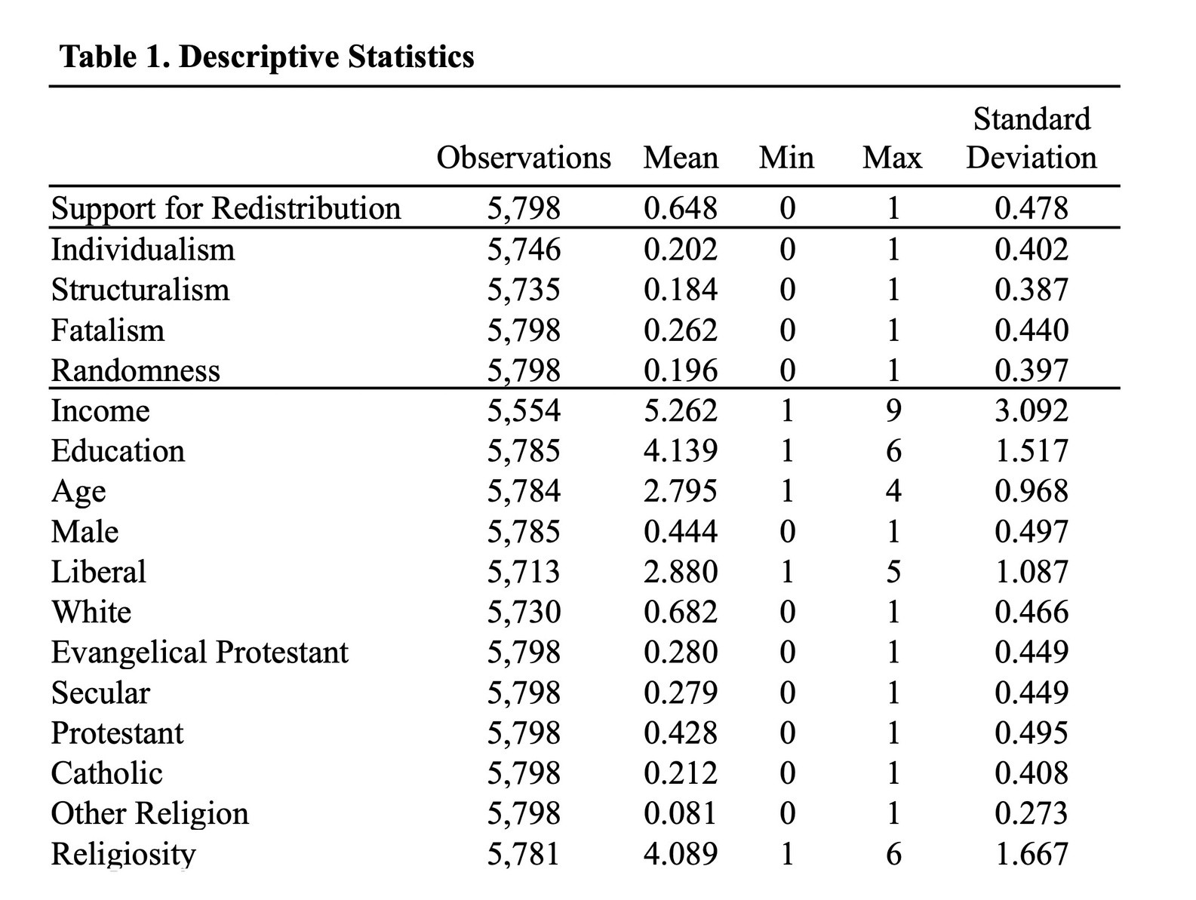

Slide 18
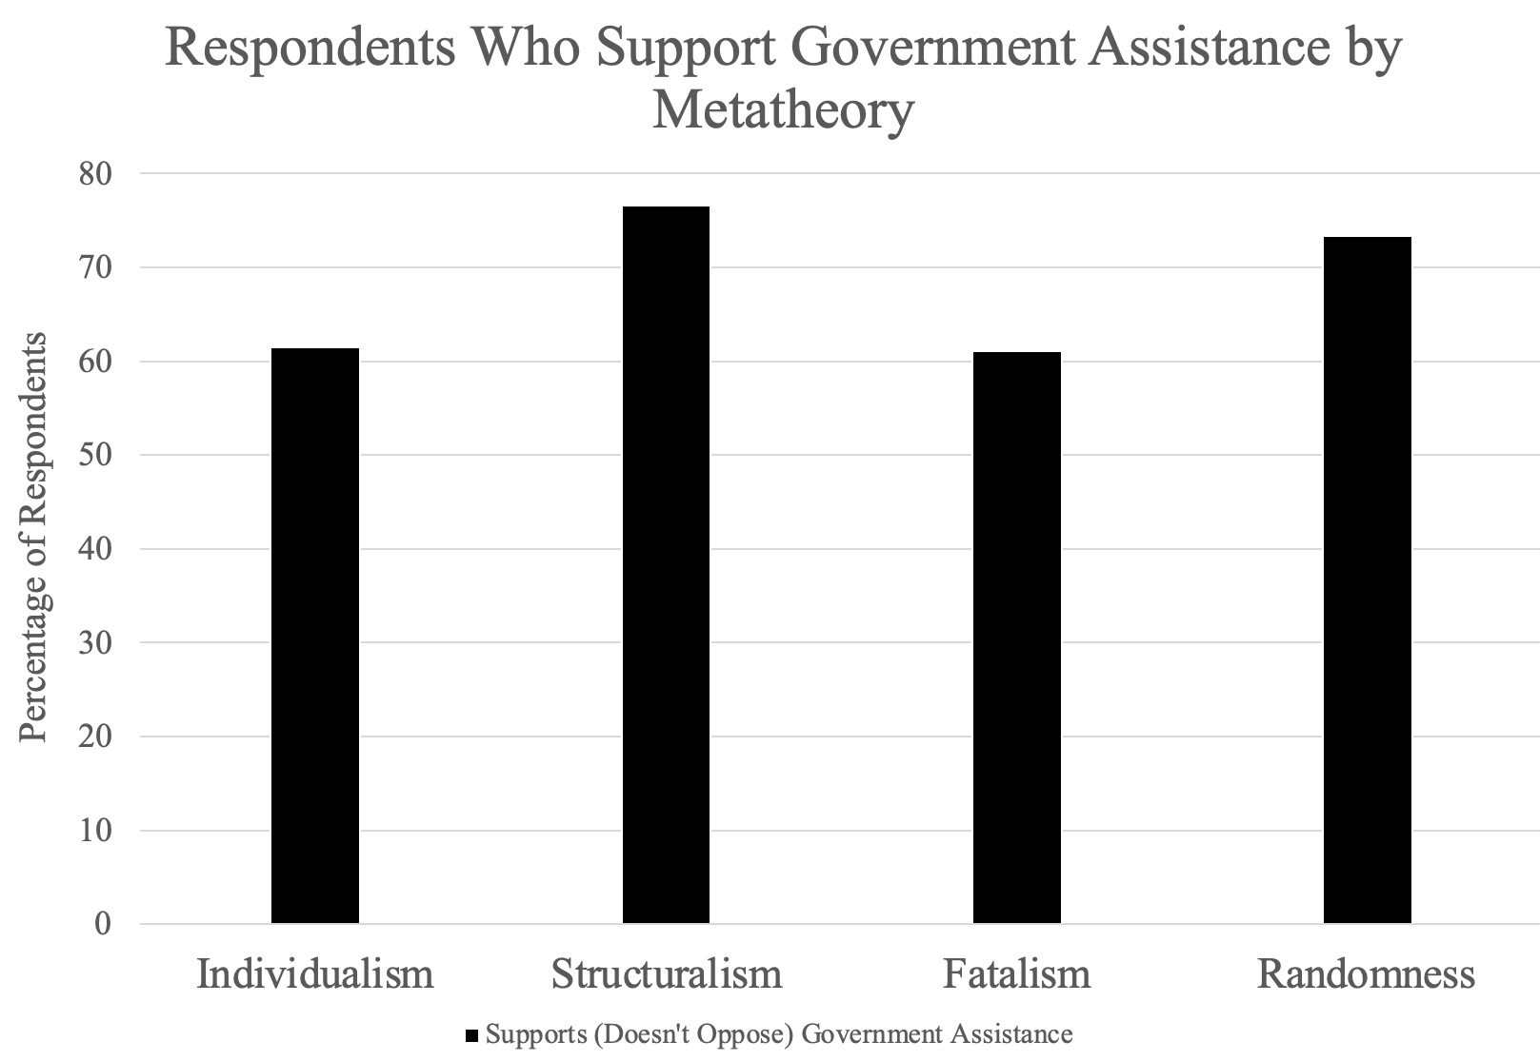

Slide 19
CONCLUSIONS
H1: Individuals who say that suffering is mostly a consequence of people’s own actions (individualism) will be less likely than individuals who do not to support redistributive economic policy (SUPPORTED)
H2: Individuals who say that suffering is mostly a result of the way society is structured (structuralism) will be more likely than individuals who do not to support redistributive economic policy (SUPPORTED)
H3: Individuals who express fatalism will be less likely than individuals who do not to support redistributive economic policy (NOT SUPPORTED)
H4: Individuals who express randomness will be more likely than individuals who do not to support redistributive economic policy (SUPPORTED)

