Slide 1
WHY DID BRAZILIANS VOTE FOR THE “TROPICAL TRUMP”?
Mark Setzler, High Point University
msetzler@highpoint.edu

Slide 2
My main research question
To what extent did Jair Bolsonaro’s election in 2018 depend on his support from voters who shared his illiberal views?

Slide 3
Why ask this question?
Many media and academics have made explicit Bolsonaro-Trump comparisons, pointing similarities in their leadership styles and especially their overlapping controversial views on minority rights, the role of the military in society, and the value of democracy.
More generally, there are comparisons between Trump’s political success and non-US right-wing/nationalist leaders & movements around the world (“Trump effect”; “Trump-like”)
Research on the US election indicates that Trump’s margin of victory depended on his ability to attract nearly universal support from highly racist, sexist, and authoritarian voters
But… Voters in Brazil and the US were in a very different situation when they last voted for presidential candidates

Slide 4
HypothesIs 1: illiberalism explains VOTing FOR BOLSONARO
H1a: More disagreement that “democracy is better than others forms of government” increased the prob. of voting for Bolsonaro
H1b: Thinking coups can be “justified” in periods with “high crime/corruption” increased the prob. of voting for Bolsonaro
H1c: More agreement that “men make better political leaders than women” increased the prob. of voting for Bolsonaro
H1d: More disapproval with the “right” of “homosexuals” to run for political office increased the prob. of voting for Bolsonaro

Slide 5
Hypotheses II: “STANDARD” issues explain voting FOR BOLSONARO
H2a: Being an evangelical Protestant (“Pentecostal”) increased the prob. of a Bolsonaro vote
H2b: Being more conservative increased the prob. of a Bolsonaro vote
H3c: Perceptions of worse economic outcomes increased the prob. of a Bolsonaro vote
Note: In the article version, I added a variable for animosity to the Workers Party (AntiPetismo)

Slide 6
Data and measurement
Data: 2019 (February) AmericasBarometer; N = 1,006 with voting data (of 1,498); SVY methods and weights applied to all analyses.
DV (0/1): Vote choice in the first-round, including blank and null votes. Bolsonaro = 1.
IVs (all re-coded to range 0->1): Anti-democratic (7pts), Support coups (0/1); Sexist (3pt); Homophobic (3pt); Evan. Prot (0/1); Personal economy worse (3pts), Conservative (10pts).
Controls (all 0/1): male, <36 years, completed high school, White/Asian, lives in SE/S, >$500US monthly

Slide 7
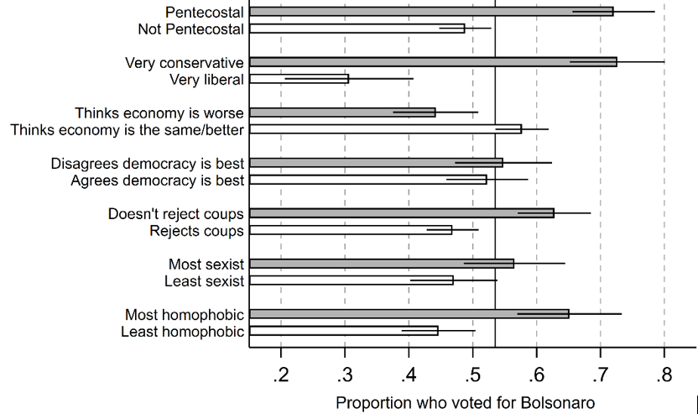
Proportion of Respondents Who Voted for BolsonarO

Slide 8
CONCLUSIONS
Looking just at bivariate analyses, Bolsonaro voters were: More pro-coup, homophobic, and more conservative But not more anti-democratic, sexist, or concerned about the economy
With controls and isolating the influence of different factors: Being pro-coup and homophobic predicted a Bolsonaro vote; however, conservatism was a much more powerful predictor.
Most of what predicted a Bolsonaro vote wasn’t anything I looked at: R-square of the full model = .15
Like what scholars have found looking at racism, sexism, and authoritarianism among the US population in 2016, many Brazilians share Bolsonaro’s controversial views
But, many individuals who rejected Bolsonaro’s controversial views still voted for him (and the same was true of Trump)
And, unlike Trump’s supporters, many voters who shared Bolsonaro’s controversial views did not vote for him
This finding holds across gender (and race—not shown—for the most part)

